Slide 1
AIML CA1 Predicting Water Quality
Adam Bin Roslan 2317425 DAAA/07

Slide 2
Table of contents
Background Research & Data Exploration
Feature Engineering
Modelling and Evaluation
Model Improvement

Slide 3
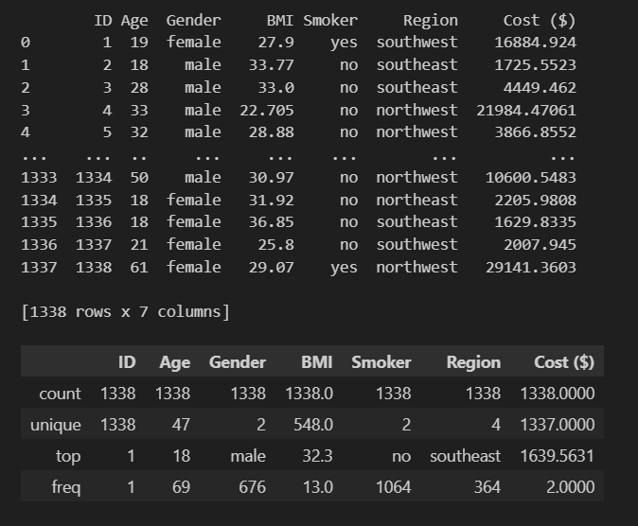
Background research and data exploration
The objective of the assignment is to predict the hospital Cost in US hospitals based on various patient information, such as ID, Age, Gender, BMI, Smoker and Region.
Information about the dataset which shows different columns and various information about the patients in the hospital

Slide 4
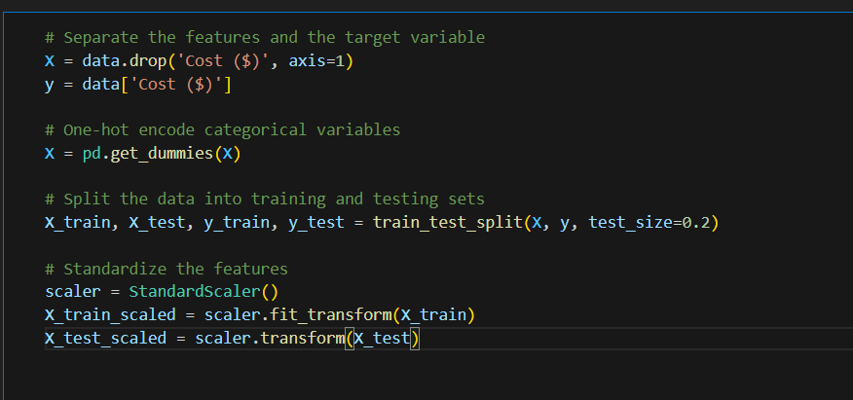
Feature engineering
the code prepares the data for a machine learning model by separating features and target variable, one-hot encoding categorical variables, and standardizing the feature values. The data is then split into training and testing sets for model training and evaluation.

Slide 5

REGRESSION MODELS

Slide 6
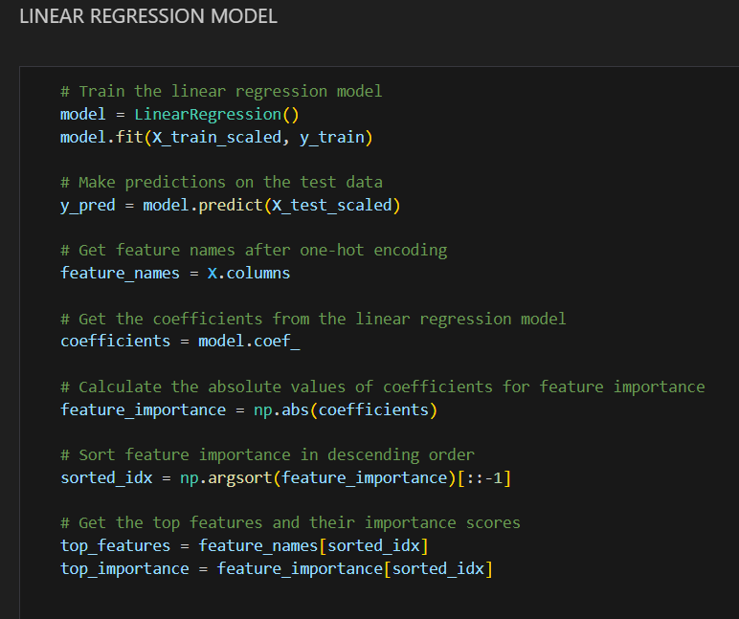
#1 Linear Regression Model
In summary, in addition to training and predicting a linear regression model, the code examines the importance of various predictors of the target variables by examining the absolute values ​​of the model parameters and then the top features and their importance scores are identified and stored for further analysis and visualization.

Slide 7
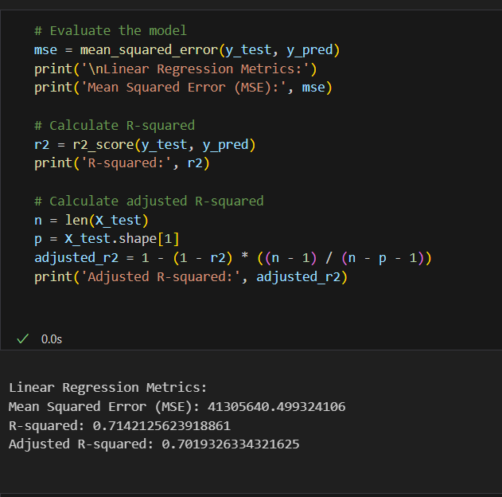
The code first calculates the mean squared error (MSE): This metric measures the average squared difference between the predicted and actual values of the target variable.
It then prints the MSE: The code prints the calculated MSE to the console.
Then, it calculates the R-squared: This metric represents the proportion of variance in the target variable that can be explained by the model.
Prints the R-squared: The code prints the calculated R-squared to the console.
Calculates the adjusted R-squared: This metric is similar to R-squared but adjusts for the number of features in the model, making it a more accurate measure of model fit.
Prints the adjusted R-squared: The code prints the calculated adjusted R-squared to the console.

Slide 8
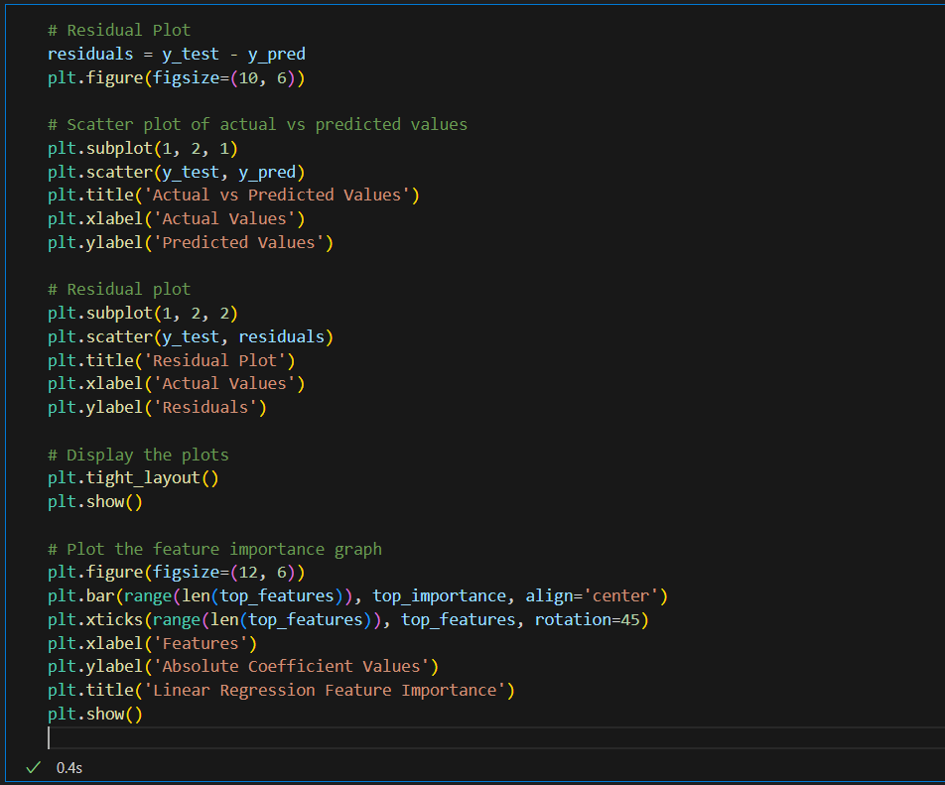
The code visually assesses the performance of the linear regression model through a residual plot, which helps identify any patterns or trends in prediction errors. Additionally, it visualizes the importance of different features in the model through a bar plot, providing insights into the contribution of each feature to the prediction.

Slide 9
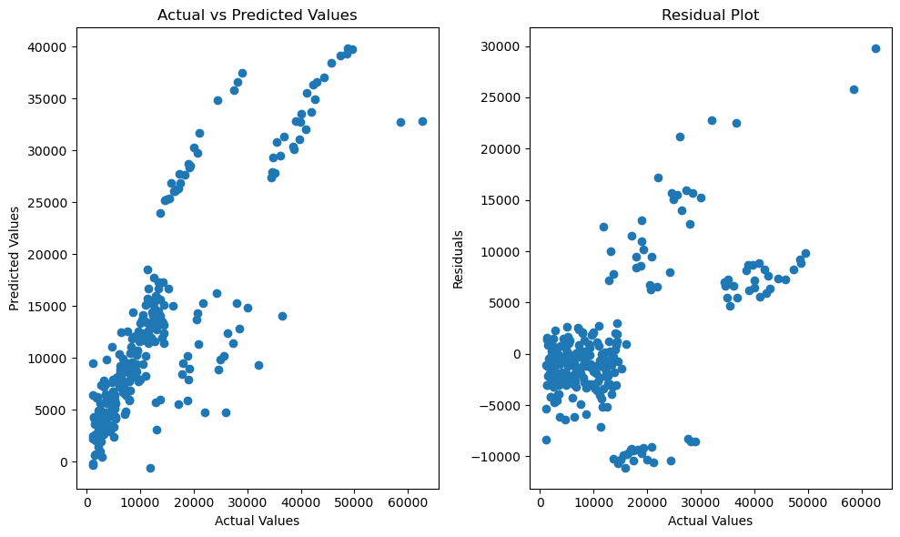
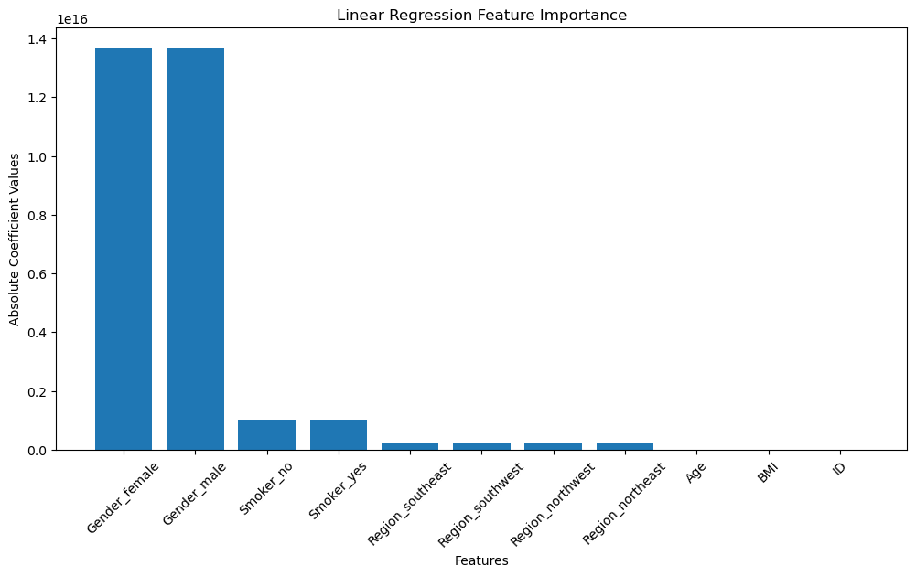
The figure shows a line graph that compares the absolute coefficient values of different features in a linear regression model. The features are listed on the x-axis, and their corresponding absolute coefficient values are shown on the y-axis. The higher the absolute coefficient value, the more important the feature is to the model.
In this case, the most important feature is Gender_female followed by "Gender_male", and “Smoker”. This suggests that these features are the most influential in predicting the target variable.
The figure shows two plots: one for actual values ​​and one for predicted values. The scatter plot shows that there is a good correlation between the actual and predicted values, but the predicted values ​​are always lower than the actual values ​​This means that the model may not be as accurate as it could be, and there are some items that sample is not captured properly

Slide 10
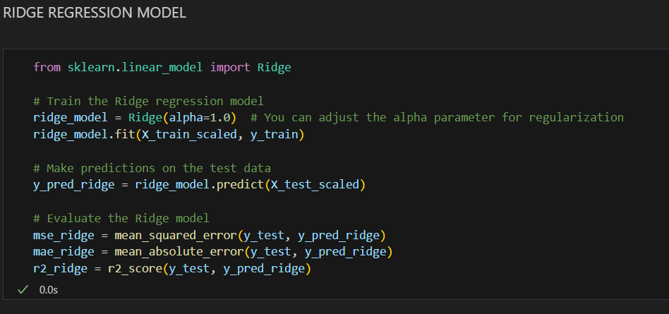
#2 Ridge Regression model
this code trains a Ridge regression model, makes predictions on test data, and evaluates the model's performance using mean squared error, mean absolute error, and R-squared metrics. The regularization parameter (alpha) can be adjusted to control the strength of regularization in the model.

Slide 11
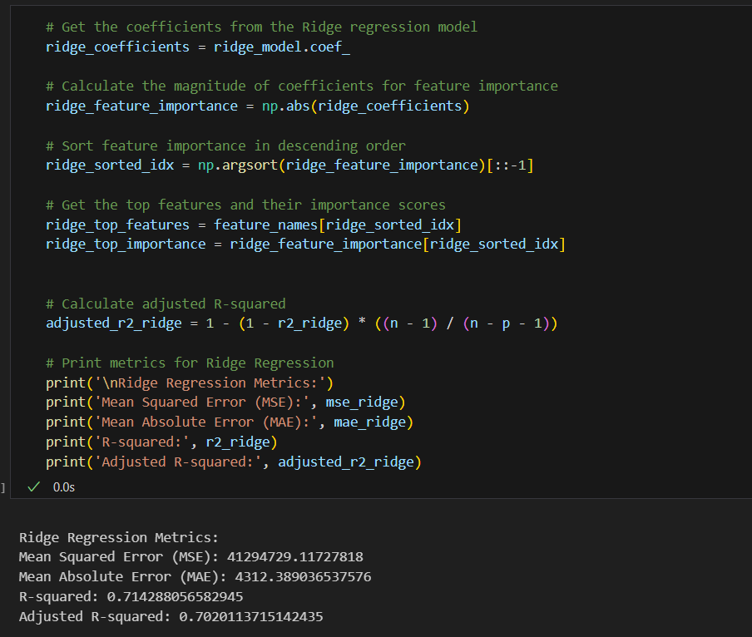
Before Hyperparameter tuning
This code provides insight into the ridge regression model by analyzing coefficients, feature importance, and other evaluation metrics including adjusted R-square These metrics help evaluate model performance and understand the importance of features importance in the case of ridge regression below.

Slide 12
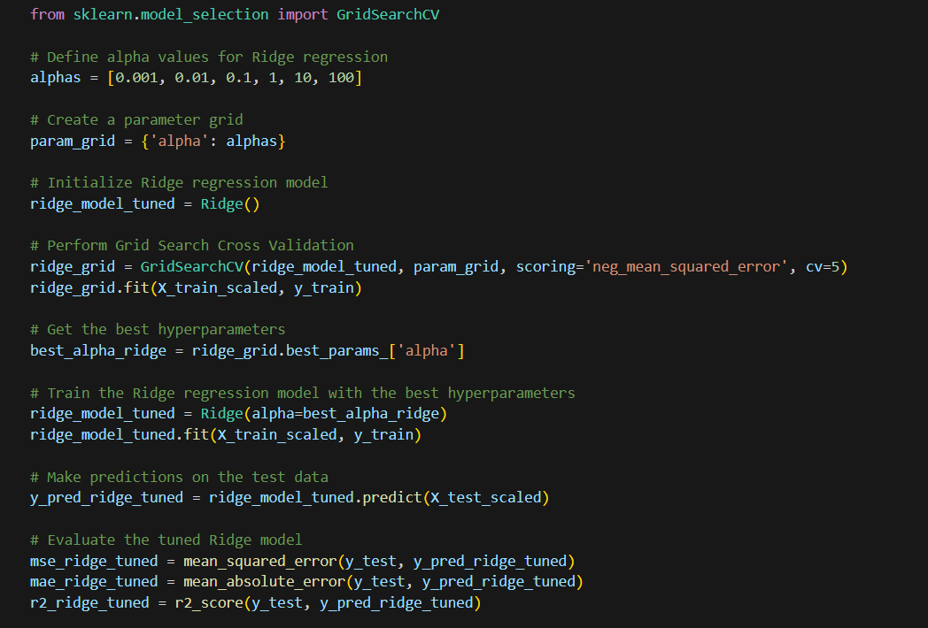
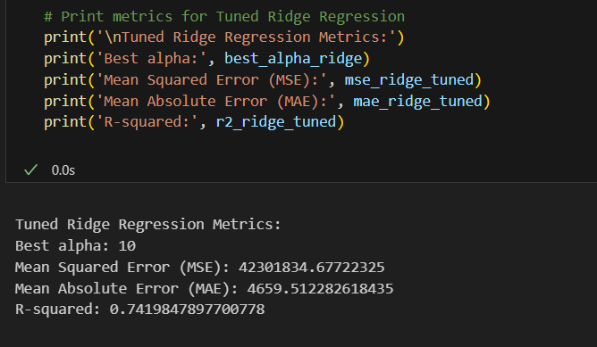
After hyperparameter tuning
this code employs grid search cross-validation to find the optimal alpha value for Ridge regression, trains a Ridge model with the best hyperparameters, and evaluates its performance using various metrics. This process helps fine-tune the model for better predictive accuracy.

Slide 13
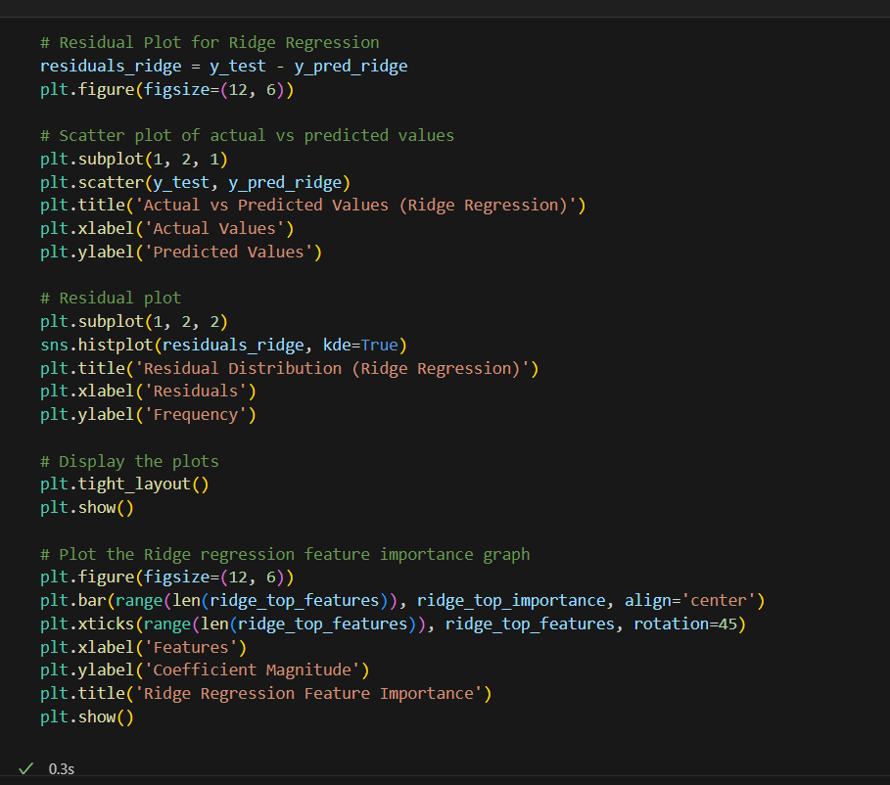
the code visually assesses the performance of the tuned Ridge regression model by examining residual plots and feature importance. The residual plots help identify any patterns or trends in prediction errors, while the feature importance graph provides insights into the contribution of each feature to the Ridge regression model.

Slide 14
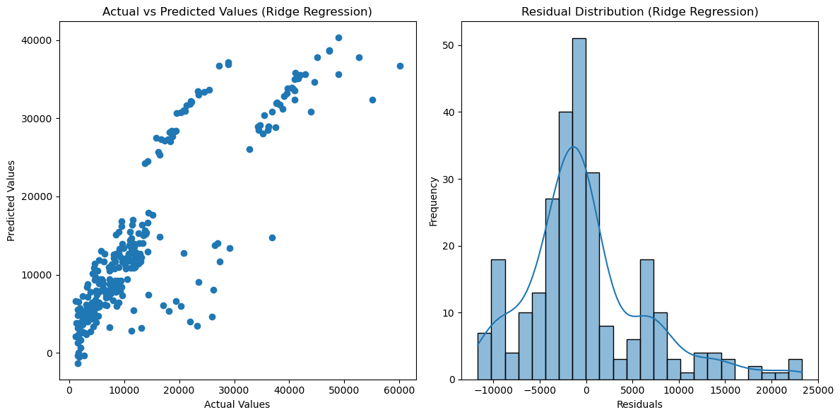
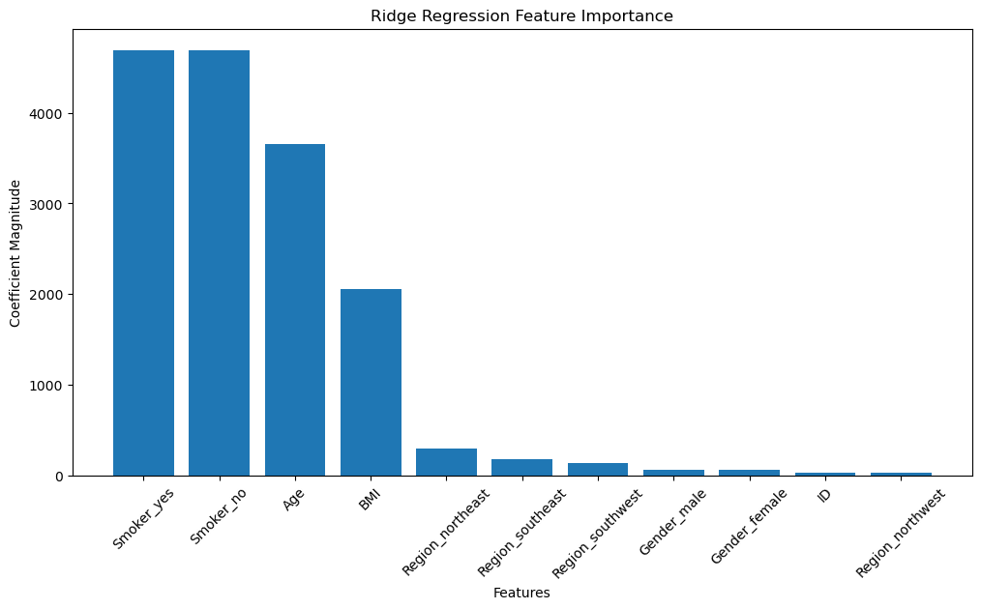
the scatter plot and histogram suggest that the regression model is performing relatively well. The actual values tend to be slightly higher than the predicted values, but the residuals are fairly evenly distributed around zero. This indicates that the model is capturing the underlying relationship between the input features and the target variable reasonably well, but there may be some factors that are not being fully captured by the model.
The image depicts a graph illustrating the relative importance of various features in a ridge regression model. The features are categorized along the x-axis, while their corresponding coefficient magnitudes are represented on the y-axis. The higher the coefficient magnitude, the greater the impact the feature has on the model's predictions. In this particular instance, "Smoker_yes" holds the highest coefficient magnitude, implying that being a smoker significantly influences the model's predictions. Next are “Smoker_no", “Age", “BMI", and “region_northwest", indicating their considerable impact as well. These features collectively contribute to the model's ability to predict the target variable.

Slide 15
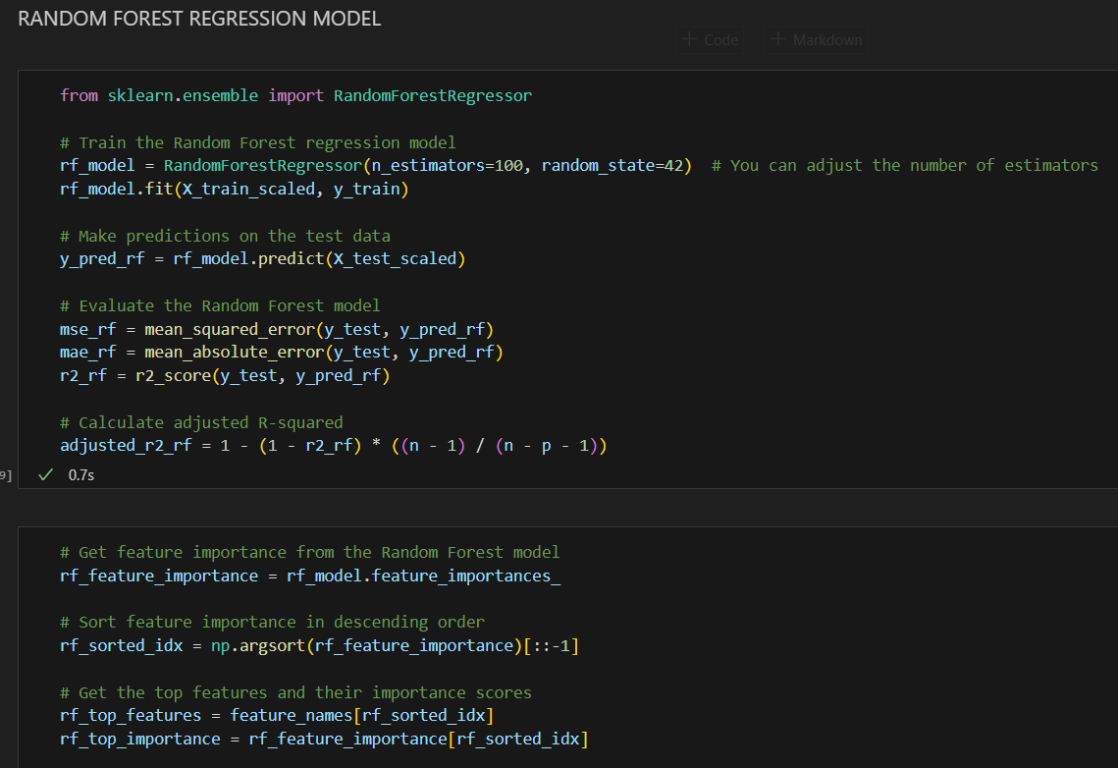
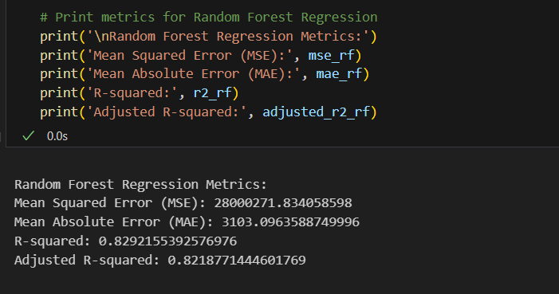
#3 Random Forest Regression Model
Before Hyperparameter Tuning
this code trains a Random Forest regression model, evaluates its performance using various metrics, and provides insights into the importance of different features in making predictions.

Slide 16
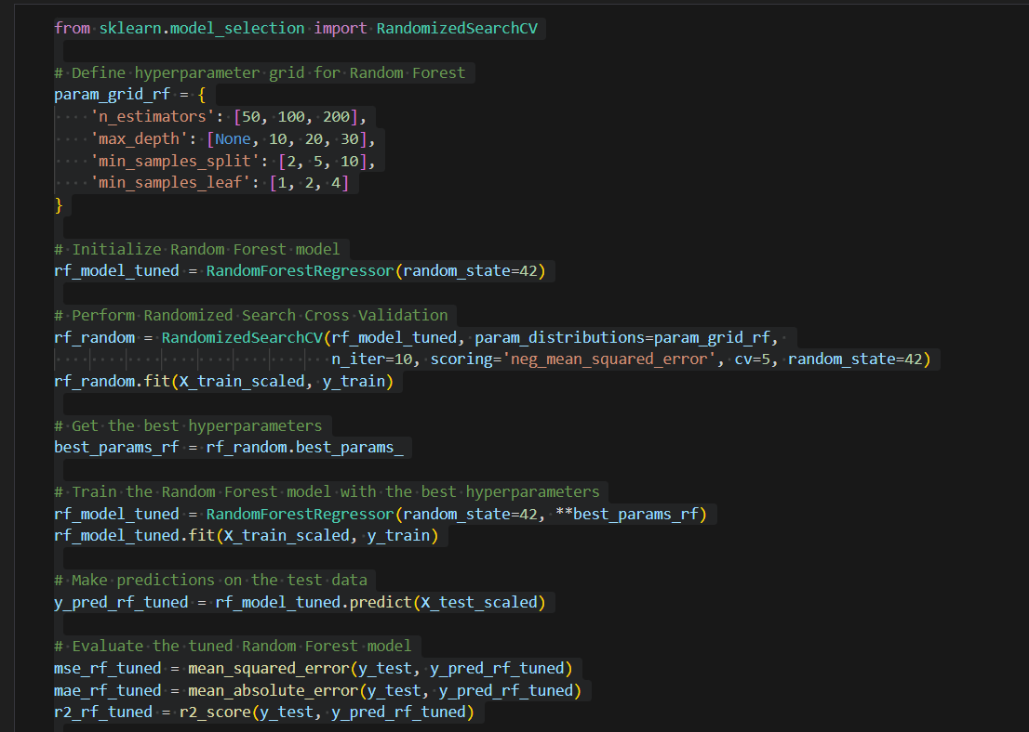
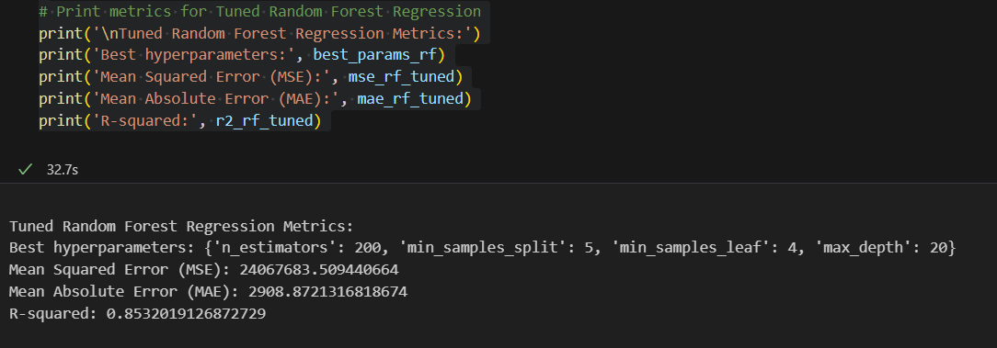
This code optimizes the hyperparameters of a Random Forest regression model through randomized search cross-validation, trains the model with the best hyperparameters, and evaluates its performance using various metrics. The goal is to enhance the model's predictive capabilities by finding the most suitable hyperparameter configuration.
After Hyperparameter tuning

Slide 17
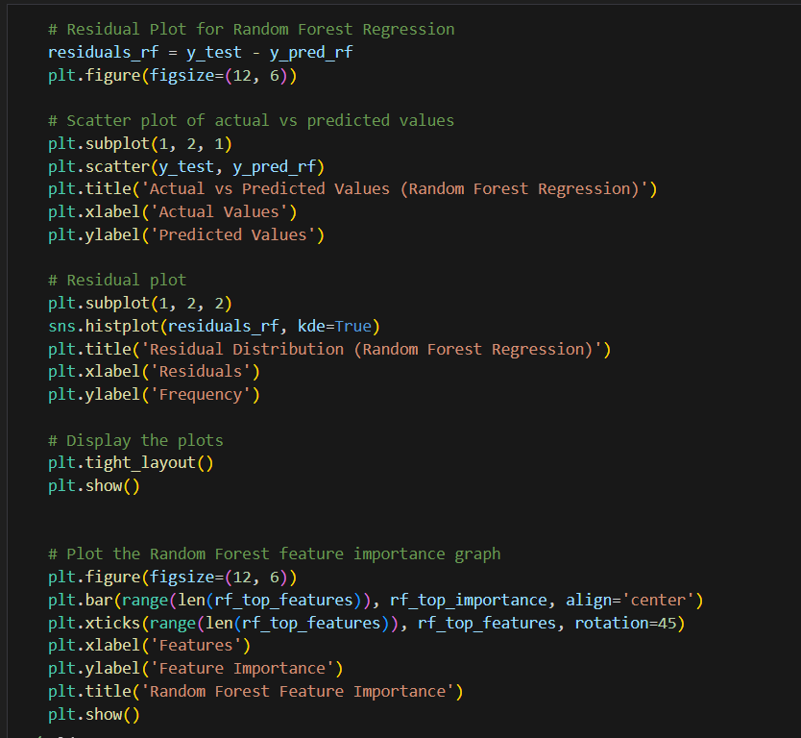
This code visually checks the performance of the random forest regression model by analyzing residual plots and feature importance. The residual plot helps to identify any patterns or trends in the prediction error, while the feature importance plot provides insight into the contribution of each feature to the random forest regression model

Slide 18
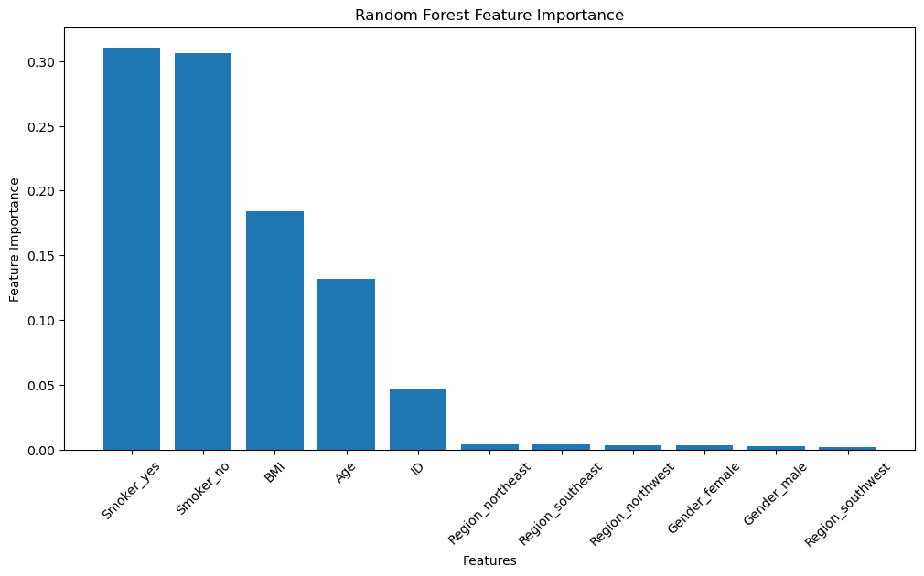
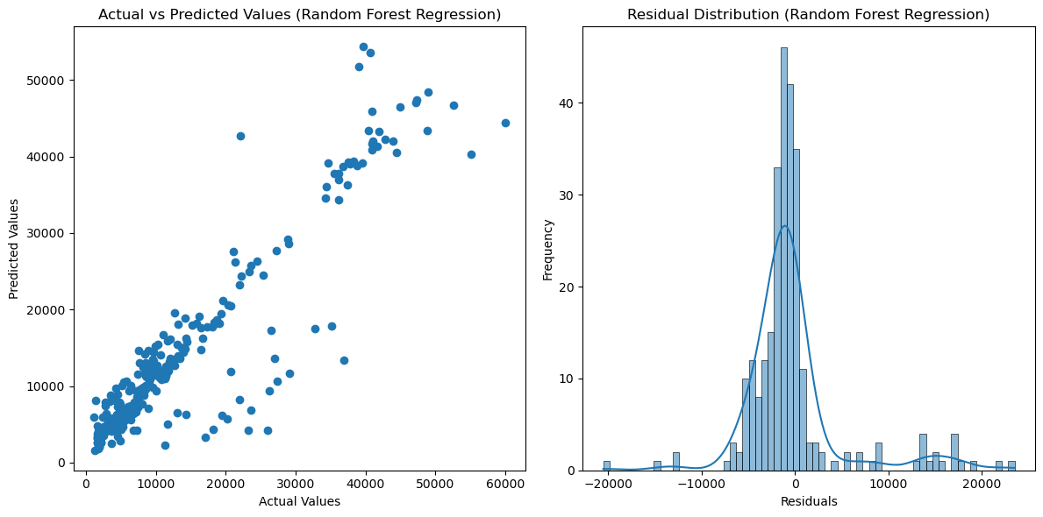
Most points cluster near the diagonal, indicating a good overall fit. However, there is a tendency for the data to fall on the diagonal line. This means that the model generally underestimates the true values. Some points diverge more significantly, indicating larger forecast errors for particular data points.
The distribution of predicted values ​​appears to be normal, involving values ​​slightly lower than actual values. This is consistent with the scatter plot observation of bias.
However, the distribution of residuals is not optimal. While most residuals cluster around zero, there is a notable skew toward positive values. This confirms that the underestimation of the sample is not random, but systematic bias.
This shows a bar graph that compares the importance of different features in a random forest model. The features are listed on the x-axis, and their corresponding importance scores are shown on the y-axis. The higher the importance score, the more important the feature is to the model.
In this case, the most important features are "Smoker_yes“ and “Smoker_no”, "BMI", “Age“. This suggests that these features are the most influential in predicting the target variable.

Slide 19
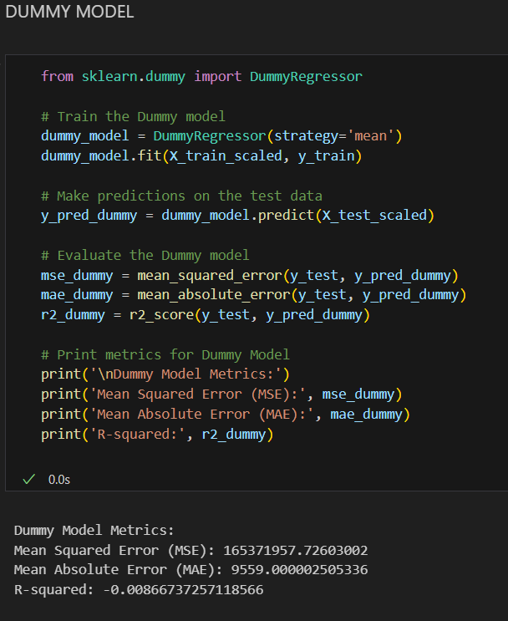
#4 Dummy Model
This code trains a simple Dummy Regressor that predicts the behavior of the target variable and evaluates its performance using basic regression metrics. The matrix of the dummy model provides a baseline for comparison with more advanced regression models, which helps to assess the predictive effectiveness of more complex models.

Slide 20
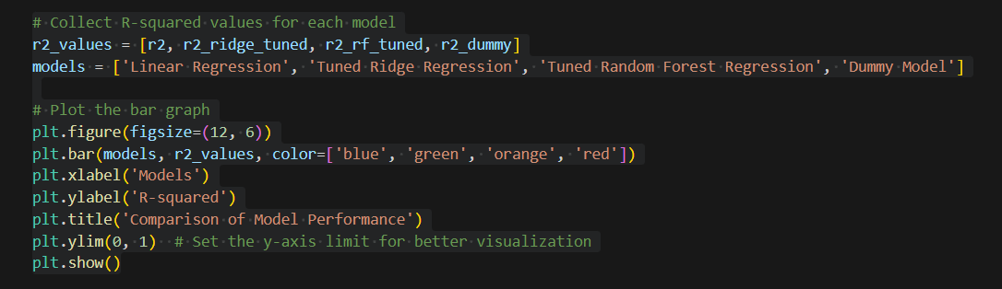
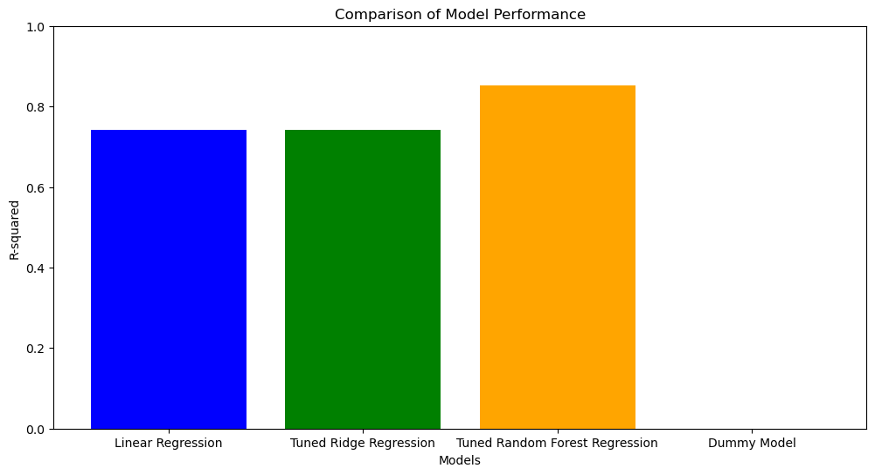
CONCLUSION
Overall, the Tuned Random Forest Regression model performed the best, followed by the Tuned Ridge Regression model, the Linear Regression model, and the Dummy Model.

